Slide 1


Web Programming 2x1
JavaScript Numbers | Strings | Dates

Slide 2
Outcomes
Students should understand the following outcomes, upon successful completion of this module:
Using Numbers
Using String
Using Date

Slide 3

Numbers
In modern JavaScript, there are two types of numbers:
Regular numbers
Regular numbers" are represented by the number data type, encompassing both integers and floating-point numbers.
64-bit format IEEE-754, also known as “double precision floating point numbers”.
These are numbers that used most of the time, and topic of discussion in this section.

Slide 4
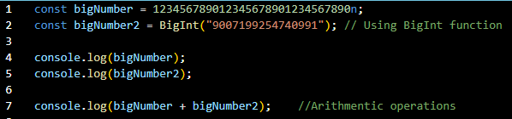
Numbers
BigInt numbers
BigInt is a relatively recent addition (introduced in ECMAScript 2020).
They allows us to work with integers of arbitrary (as large as needed) precision, beyond the limitations of the traditional number type which is 64-bit.
They are sometimes needed, because a regular number can’t exceed 253 or be less than -253.
BigInts are declared by appending n to the end of an integer literal or by calling the BigInt() function:

Slide 5

Numbers
Scientific Notation (e notation)
It is used to represent floating-point numbers, not integers or BigInts.
Scientific notation uses e or E to indicate powers of 10, typically used with floating-point numbers to represent very large or very small numbers compactly.
For example, 1.23e6 represents 1.23 multiplied by 10^6, which is 1230000.

Slide 6
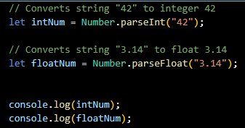
Methods of Number
The Number object provides several built-in methods that allow you to perform various operations and manipulations on numbers.
Conversion Methods - Number.parseInt() and Number.parseFloat():
These methods are used to parse strings and convert them into integers (parseInt) or floating-point numbers (parseFloat):

Slide 7


Methods of Number
Number Validation Methods
Number.isNaN() and Number.isFinite():
Conversion and Formatting Methods
Number.toFixed(), Number.toPrecision() & Number.toString():

Slide 8
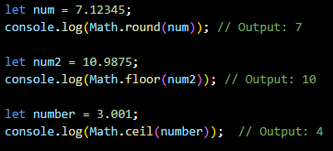
Rounding Numbers
Rounding numbers in JavaScript can be achieved using several methods provided by the Math object or directly through the Number object's methods.
Math.round() is often used when you want to round to the nearest integer.
Math.floor() and Math.ceil() are useful when you specifically need to round down or round up, respectively.

Slide 9
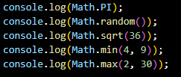
Math Object
The Math object in JavaScript provides a set of built-in mathematical functions and constants that allow you to perform complex mathematical operations.
These functions are static, meaning you call them directly on the Math object itself, rather than on instances of the object.
Math.PI: Represents the ratio of the circumference of a circle to its diameter, approximately 3.14159.
Math.random() generates a pseudo-random number between 0 (inclusive) and 1 (exclusive).
Math.sqrt() for square root.
Math.min() & Math.max() for min and max numbers.

Slide 10

Exercise
Q1: The formula for the surface area A of a cylinder with radius cylinder with radius 𝑟 and height ℎ is given by:
Using a Math object, create a JavaScript app to calculate the surface area when r = 24.67 and h = 12.13. Area must be correct to 4 sig figures.
Q2: Consider the following expression:
What will console.log(num) output if Math.random() generates 0.458, min = 10 and max = 100?

Slide 11

Strings
In JavaScript, the textual data is stored as strings. There is no separate type for a single character.
Strings can be enclosed within either single quotes, double quotes or backticks:
let single = 'single-quoted';
let double = "double-quoted";
let backticks = `backticks`;
Backticks allow us to embed any expression into the string, by wrapping it in ${…}.
The following JavaScript statement that demonstrates string interpolation within a template literal:

Slide 12
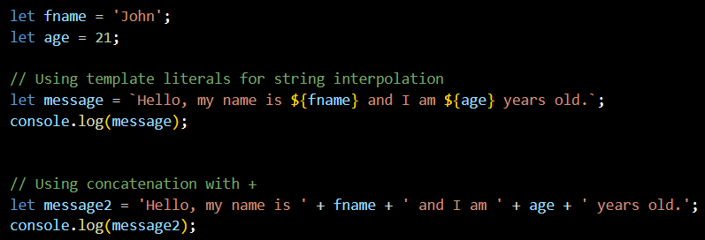
String Interpolation vs Concatenation
String expression interpolation in JavaScript refers to the ability to embed expressions directly within strings using template literals: `${…}`.
This feature allows you to easily concatenate variables, function calls, or even complex expressions into a string without resorting to traditional concatenation operator (+).

Slide 13
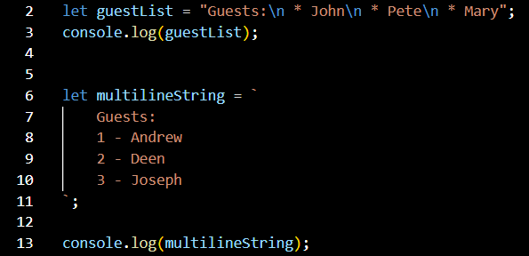
Manipulating Strings
JavaScript strings offer various methods and properties for manipulation and retrieval of data.
Modern JavaScript (ES6+) introduced template literals for cleaner multiline strings and enhanced readability.
Multiline Strings
We can use Escape characters (\n) for multiline strings, but with ES6, template literals provide a cleaner way to handle multiline strings:

Slide 14
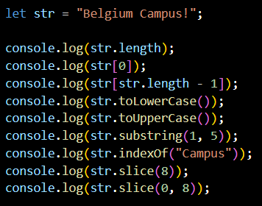
Manipulating Strings
Create and define the output of each the following:
The length property of a string returns the number of characters in the string.
You can access characters in a string using bracket notation ([]). Indices start at 0 for the first character.
Return a new string with all characters converted to lowercase or uppercase.
The substring() method extracts characters from a string between two indices (start inclusive, end exclusive).
The indexOf() method returns the index of the first occurrence of a specified substring within the string.
The slice() method extracts a section of a string and returns it as a new string, without modifying the original string.
Notes:
15
B
!
belgium campus!
BELGIUM CAMPUS!
elgi
8
Campus!
Belgium

Slide 15
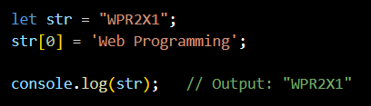
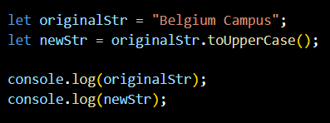
Immutable Strings
Strings in JavaScript are immutable sequences of characters.
Immutable means that once a string is created, its content cannot be changed.
Any operation that appears to modify a string actually creates and returns a new string with the modified content, leaving the original string unchanged:
Operations like concatenation, substring extraction, or methods like toUpperCase() and toLowerCase() do not alter the original string:

Slide 16
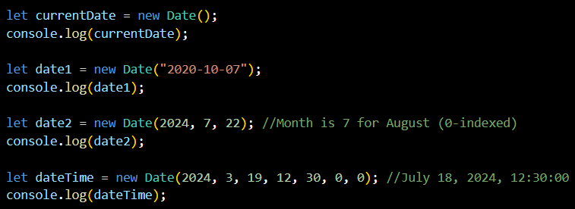
Date Object
The Date object is used for working with dates and times.
It provides methods for creating, manipulating, and formatting dates and times.
Create a new Date object:

Slide 17
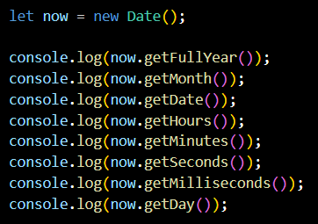
Date Methods and Properties
The Date object provides various methods to work with dates and times:

Slide 18
Thank You!
The End
/belgiumcampusSA
#Belgium Campus
info@belgiumcampus.ac.za
+27 10 593 53 68
/belgiumcampus

